Slide 1
BLM2041 Signals and Systems
Syllabus
The Instructors:
Doç. Dr. Ali Can Karaca
ackaraca@yildiz.edu.tr
Dr. Ahmet Elbir
aelbir@yildiz.edu.tr

Slide 2
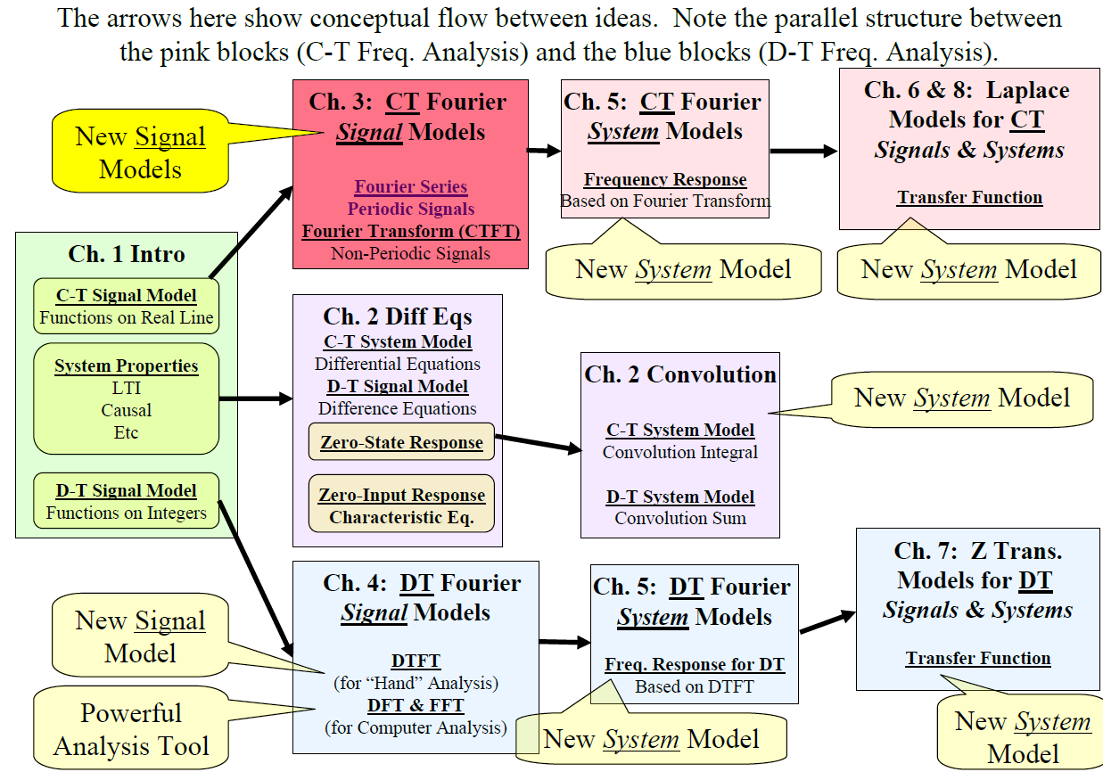
Where are we now?

Slide 3
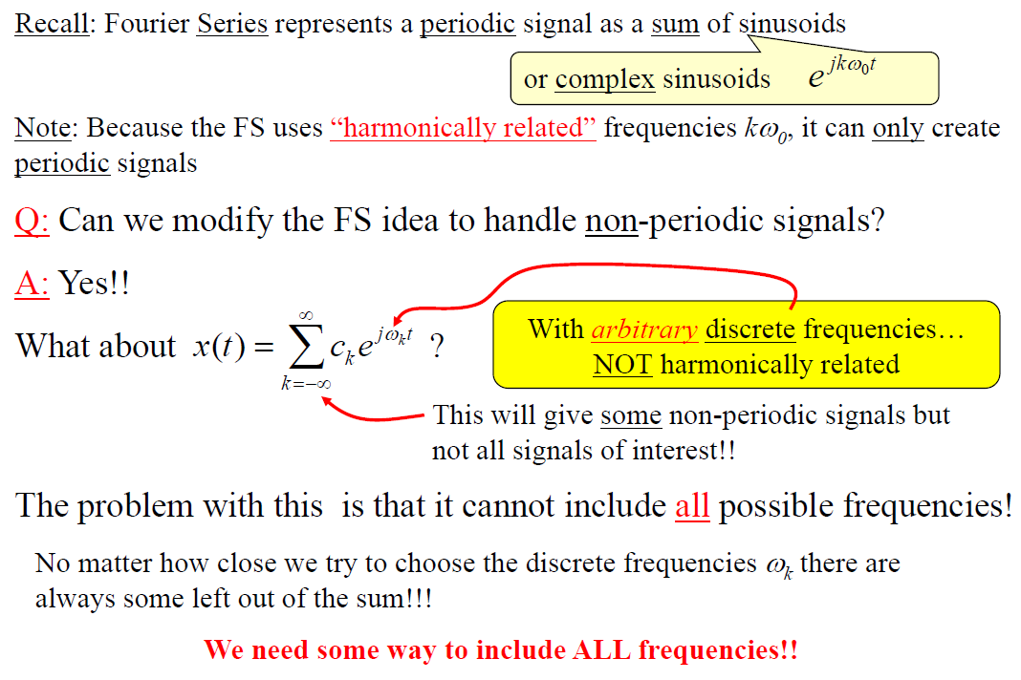
Fourier Transform

Slide 4
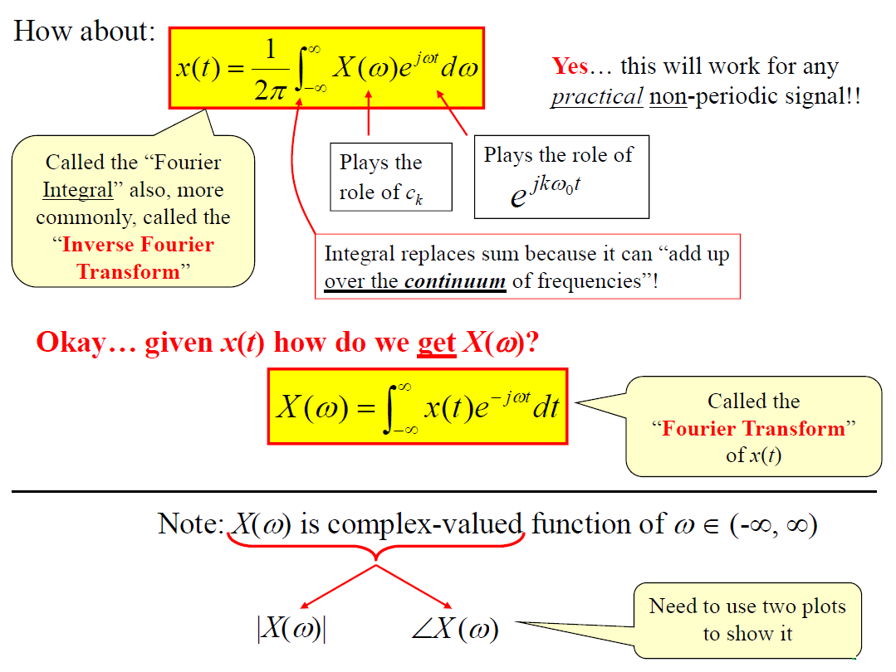
Fourier Transform

Slide 5
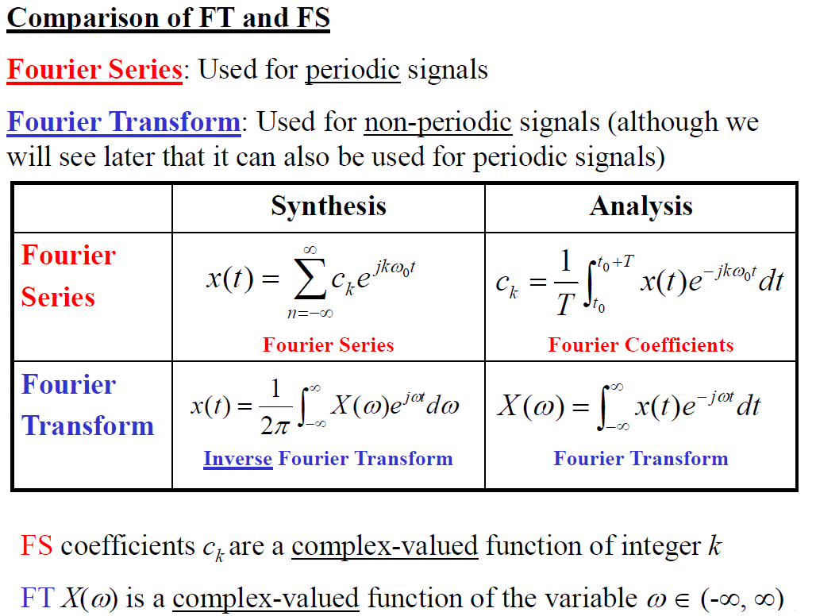
Fourier Transform

Slide 6
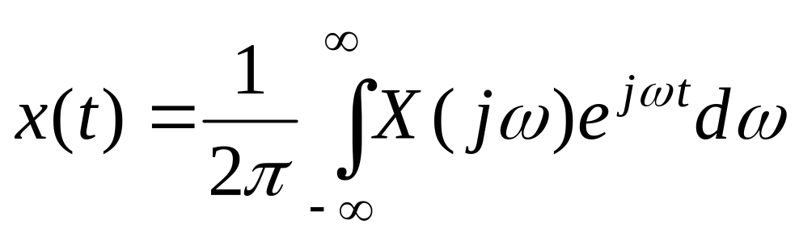
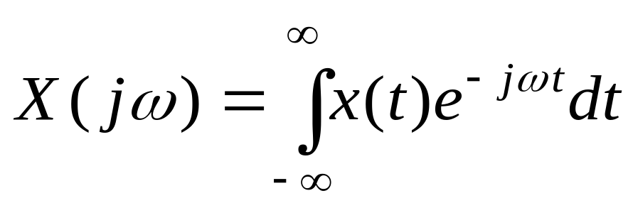

Fourier Transform Defined
For non-periodic signals
Fourier Synthesis
(Inverse Transform)
Fourier Analysis
(Forward Transform)

Slide 7
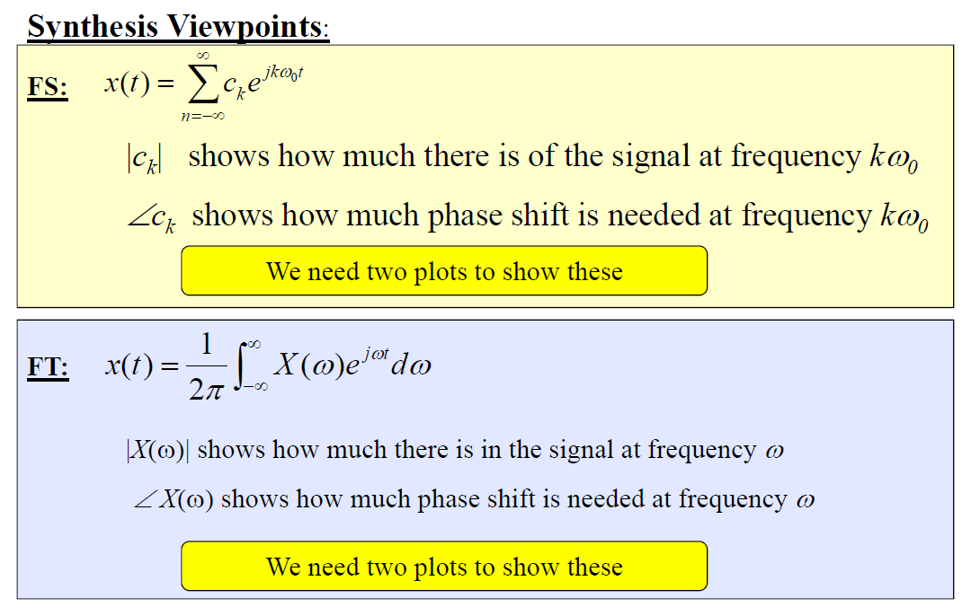
Fourier Transform

Slide 8
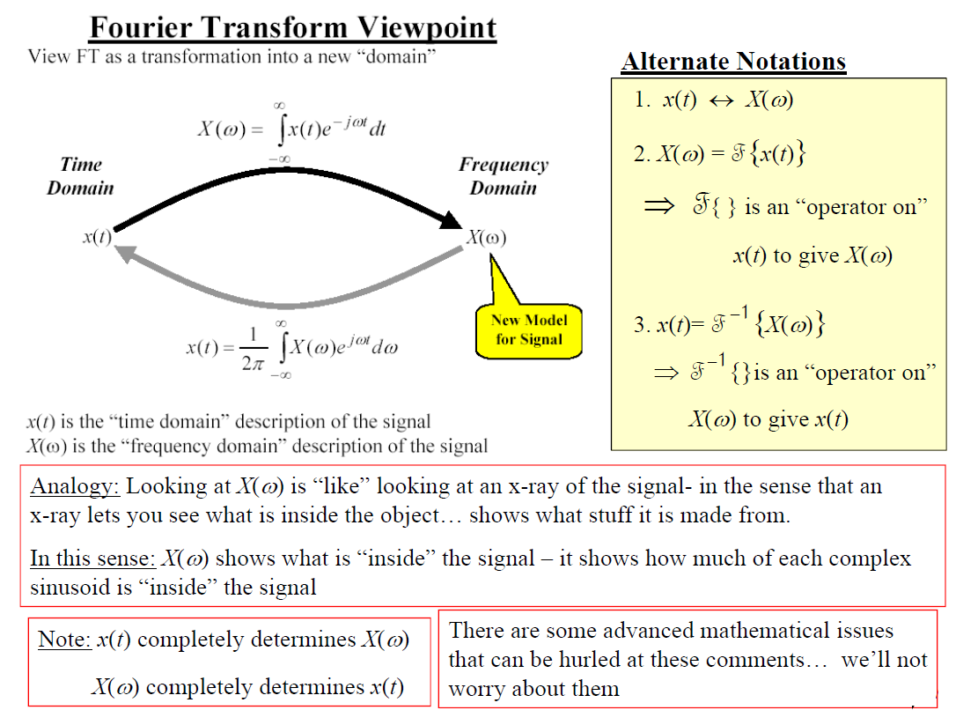
Fourier Transform

Slide 9
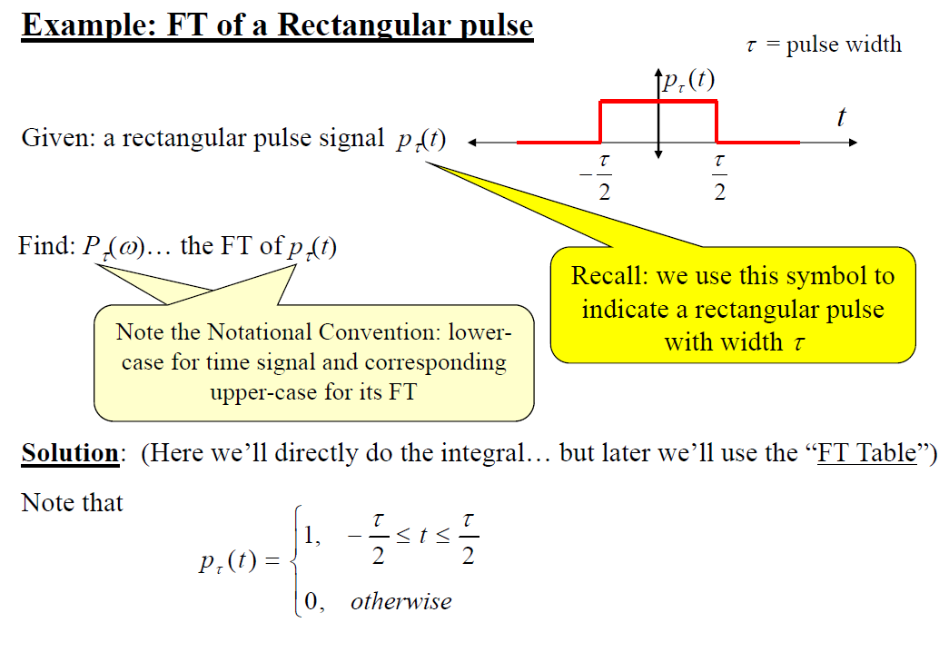
Fourier Transform

Slide 10
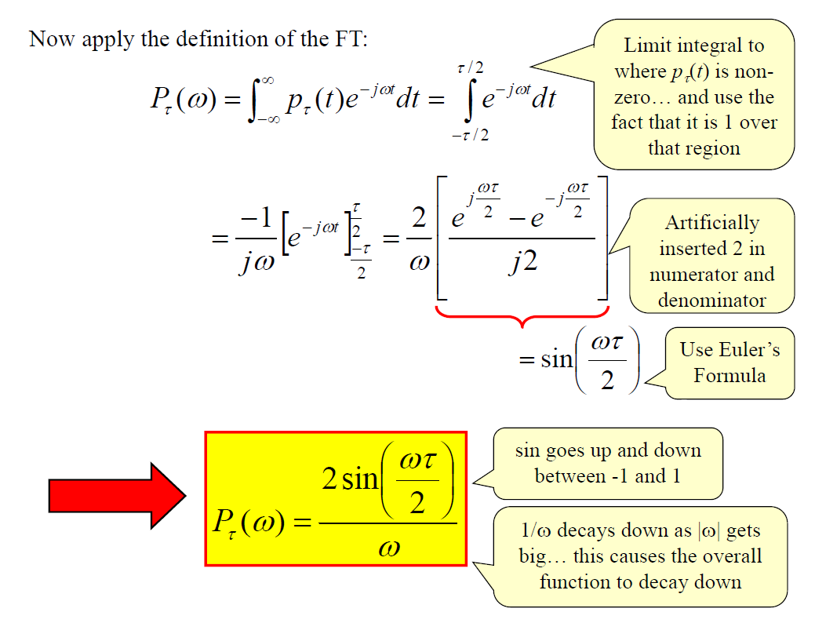
Fourier Transform

Slide 11
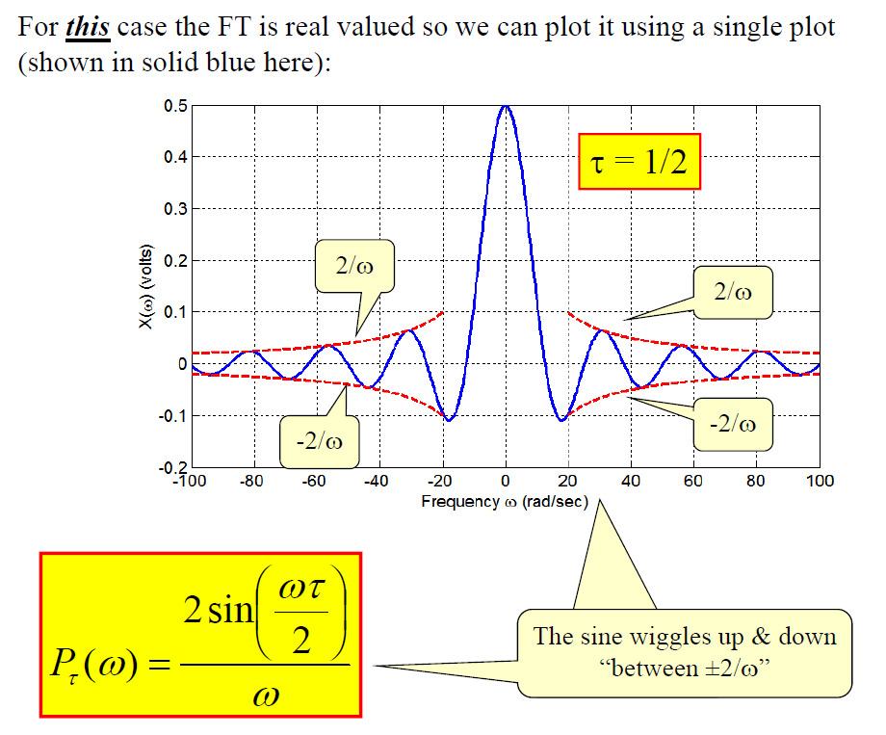
Fourier Transform

Slide 12
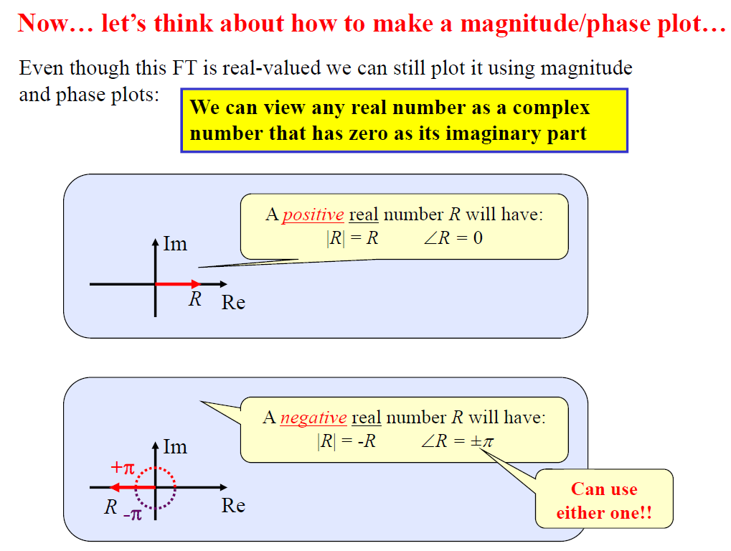
Fourier Transform

Slide 13
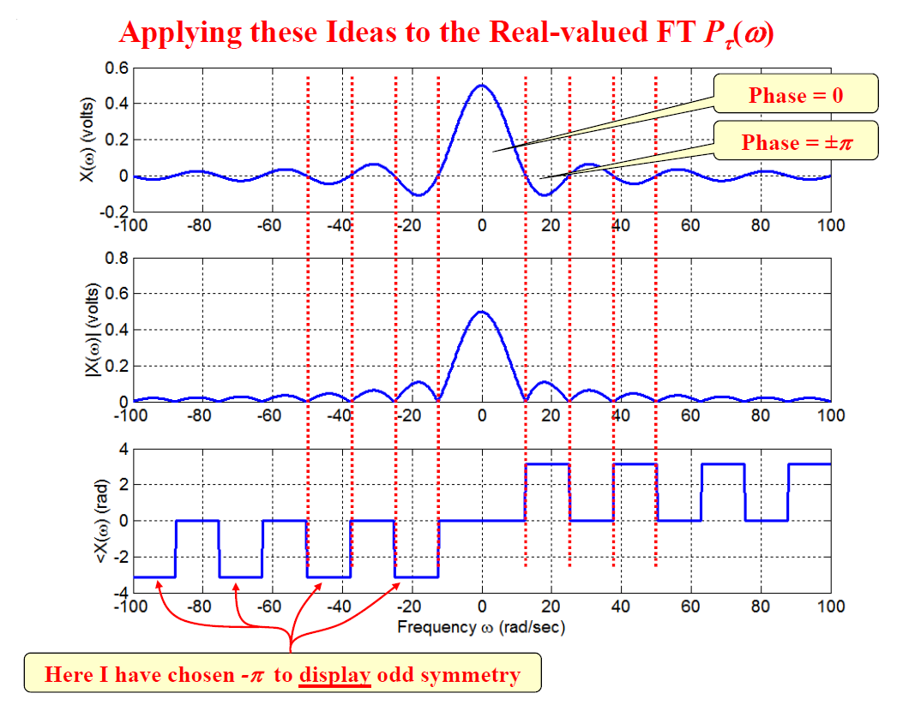
Fourier Transform

Slide 14
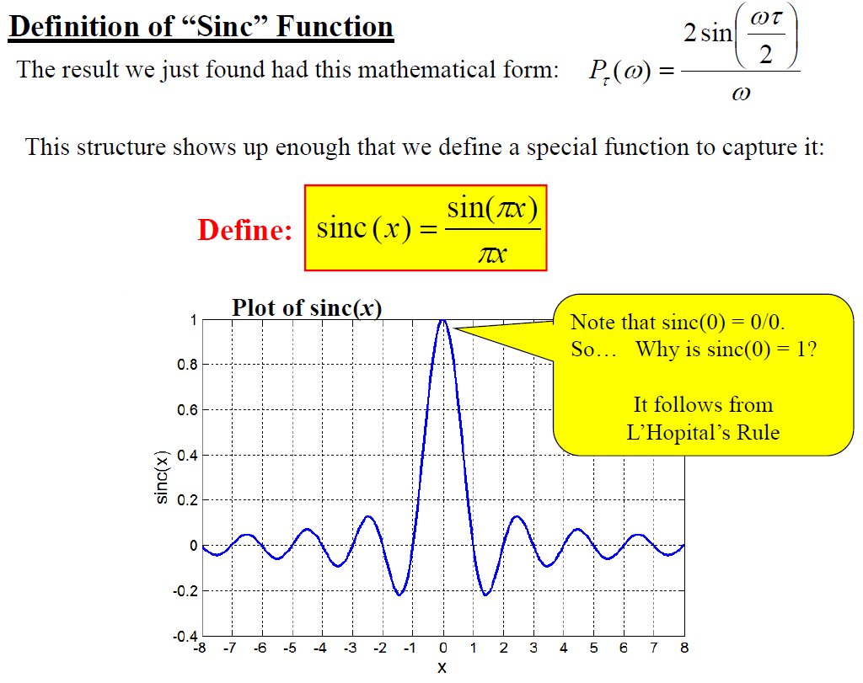
Fourier Transform

Slide 15
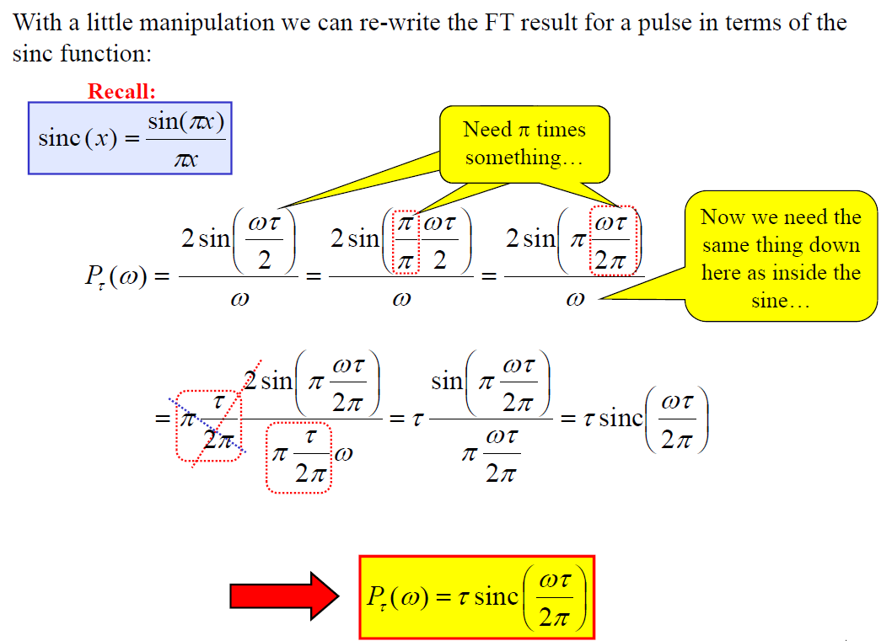
Fourier Transform

Slide 16
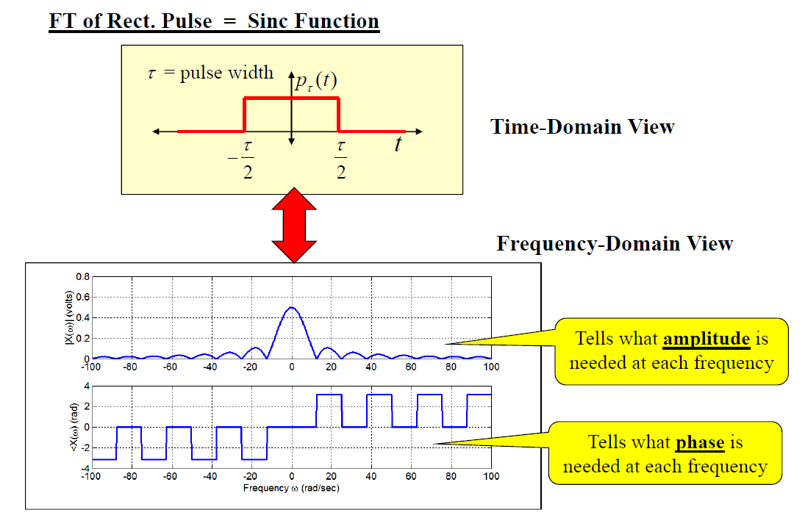
Fourier Transform

Slide 17
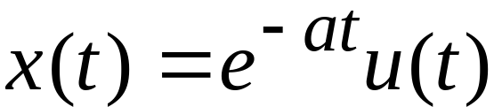
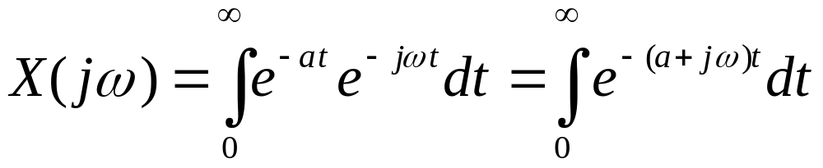

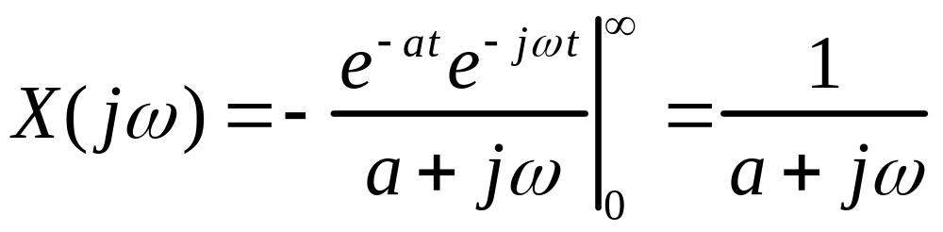
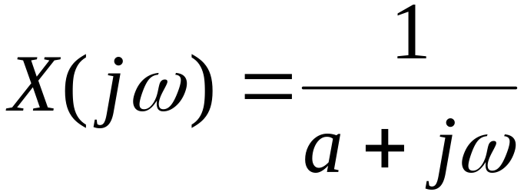
Example 1

Slide 18
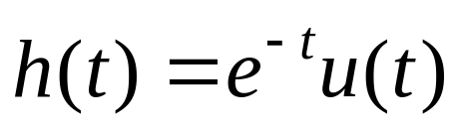
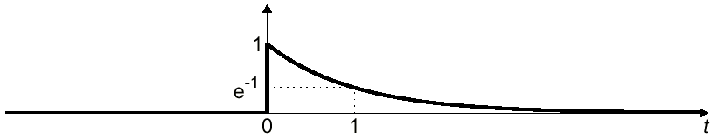
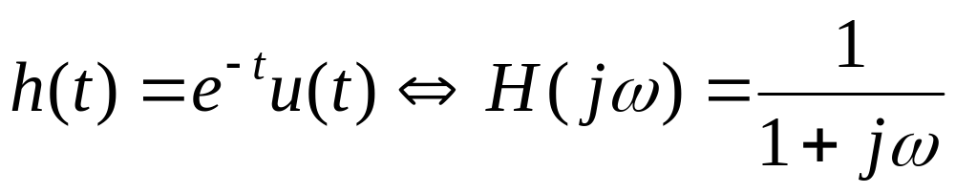
Example 1 - Frequency Response
Fourier Transform of h(t) is
  the Frequency Response

Slide 19
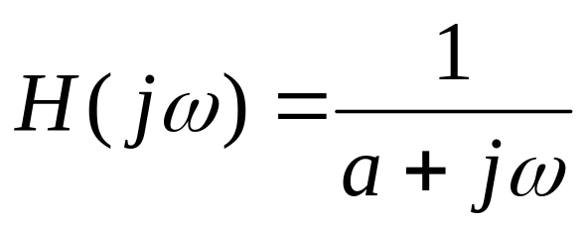
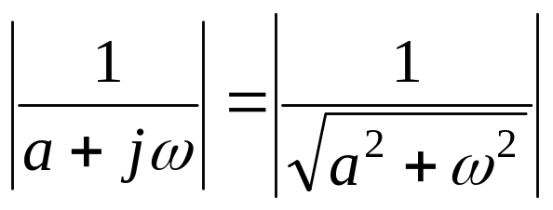
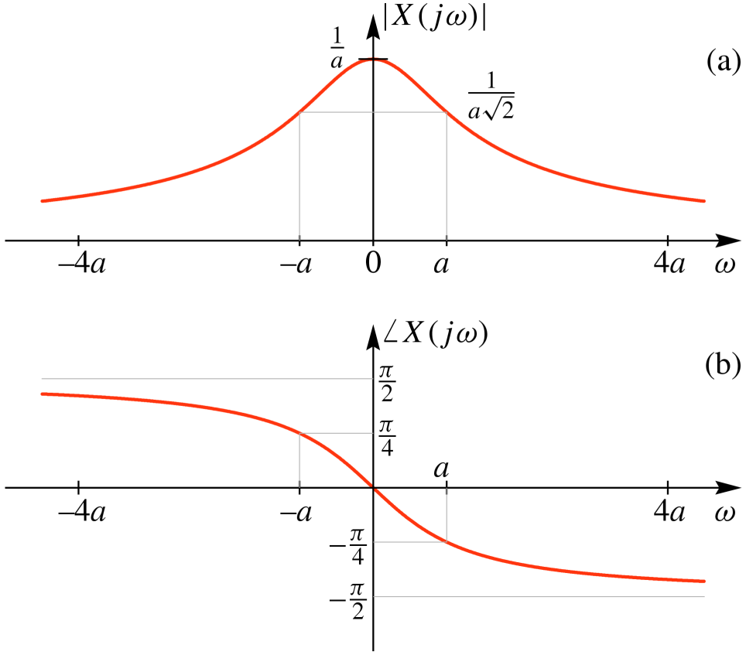
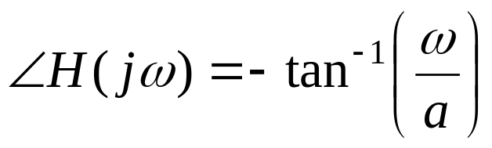
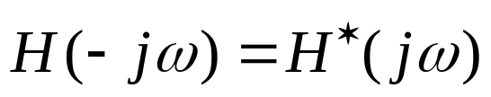
Example 1 - Magnitude and Phase Plots

Slide 20
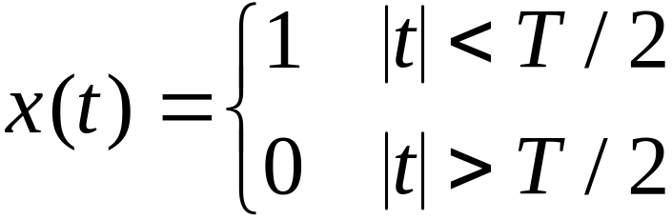
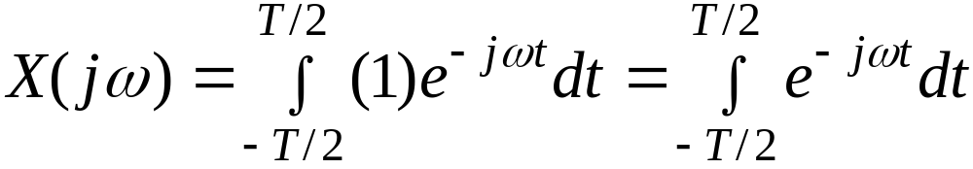
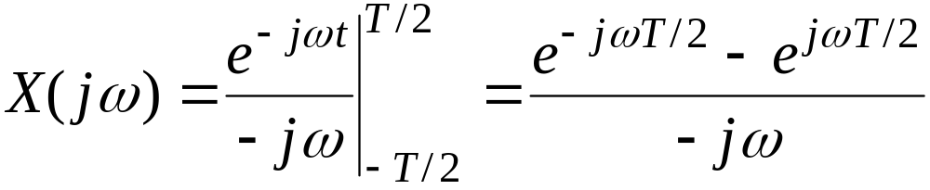
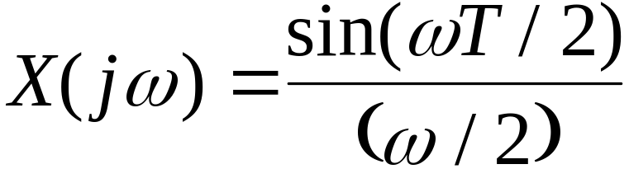
Example 2

Slide 21
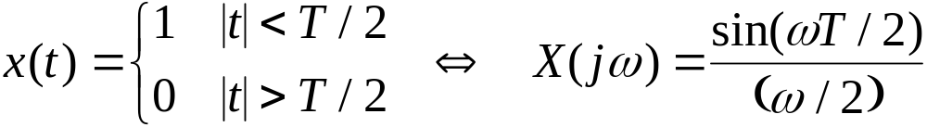
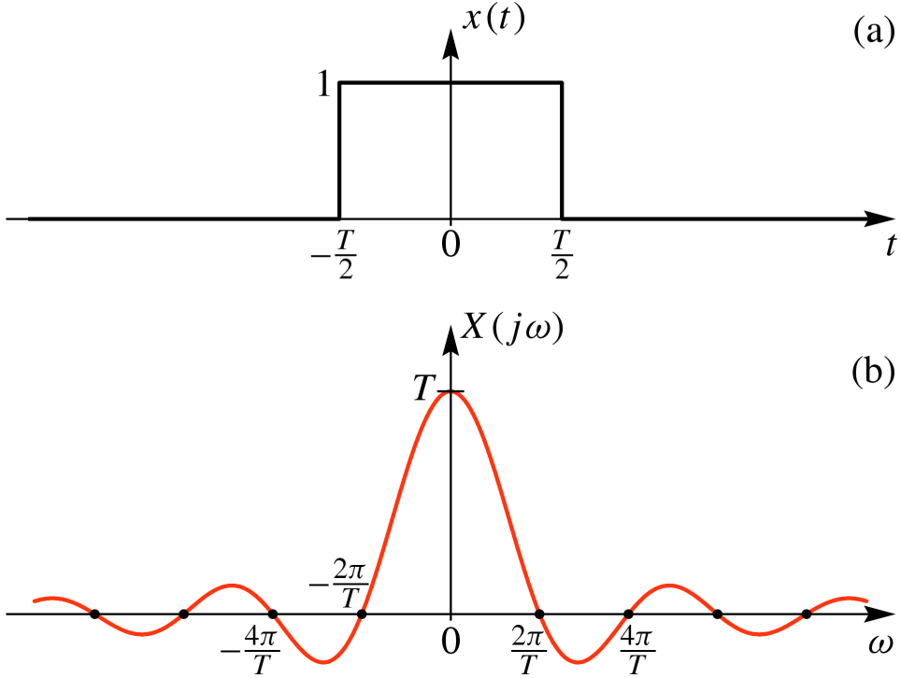
Example 2

Slide 22
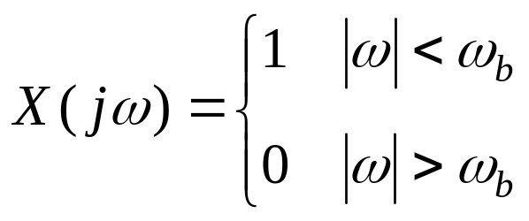
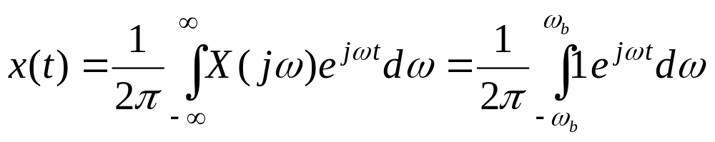
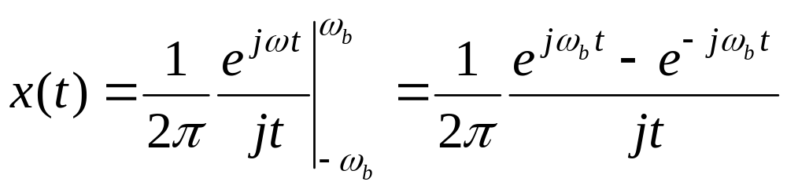
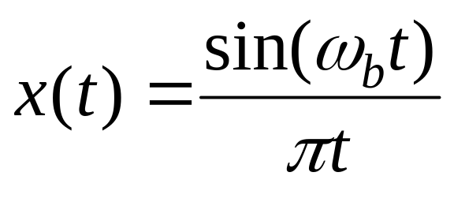
Example 3

Slide 23
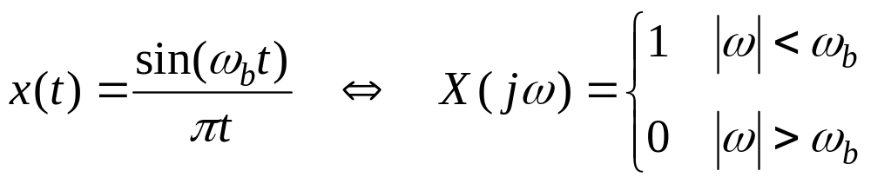
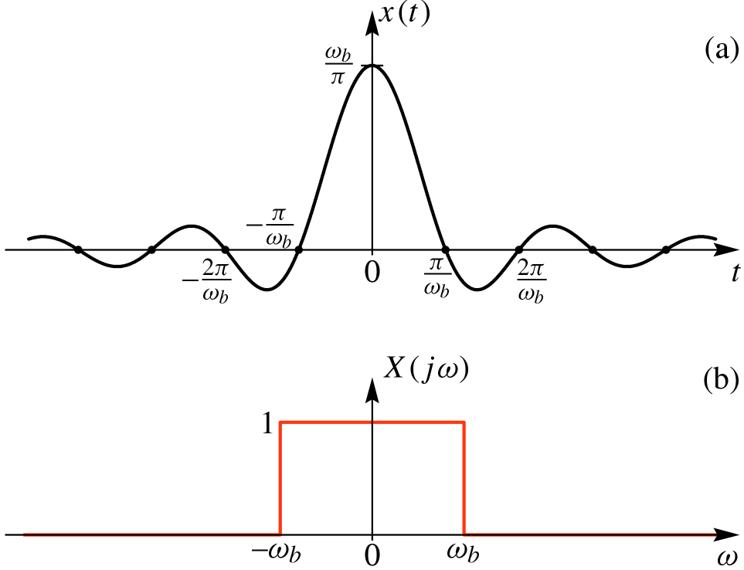
Example 3

Slide 24
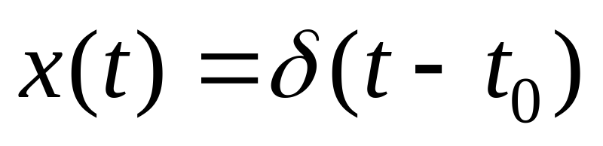
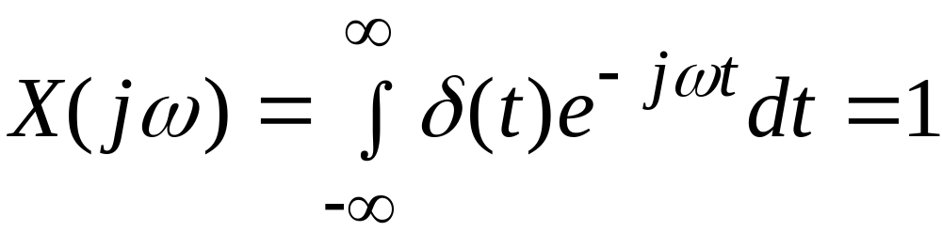
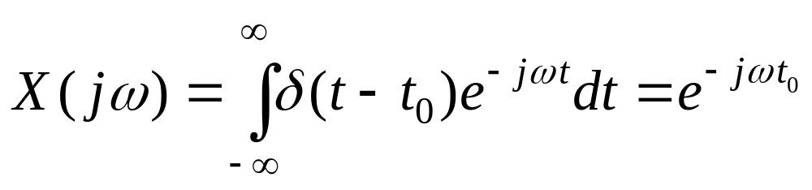
Example 4
Shifting Property of the Impulse

Slide 25
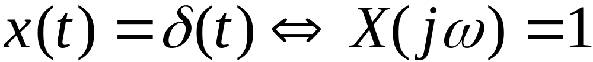
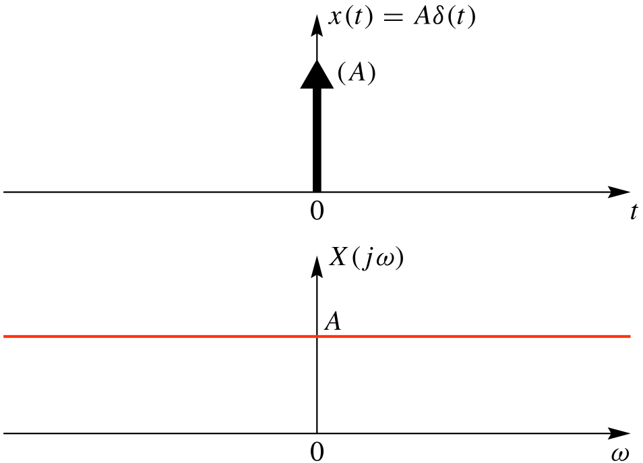
Impulse function – Time and Frequency domains

Slide 26
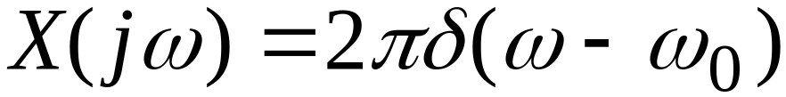
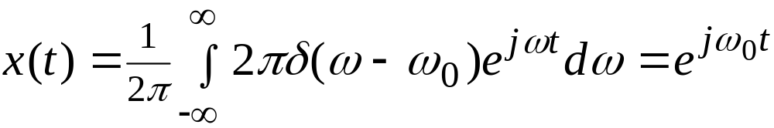
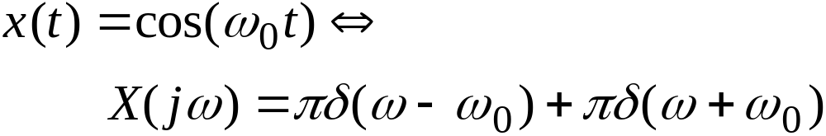
Example 5

Slide 27
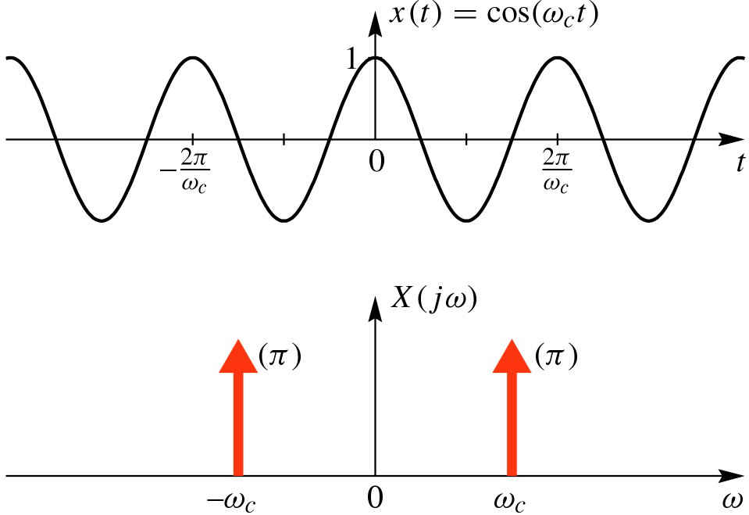
Example 5

Slide 28
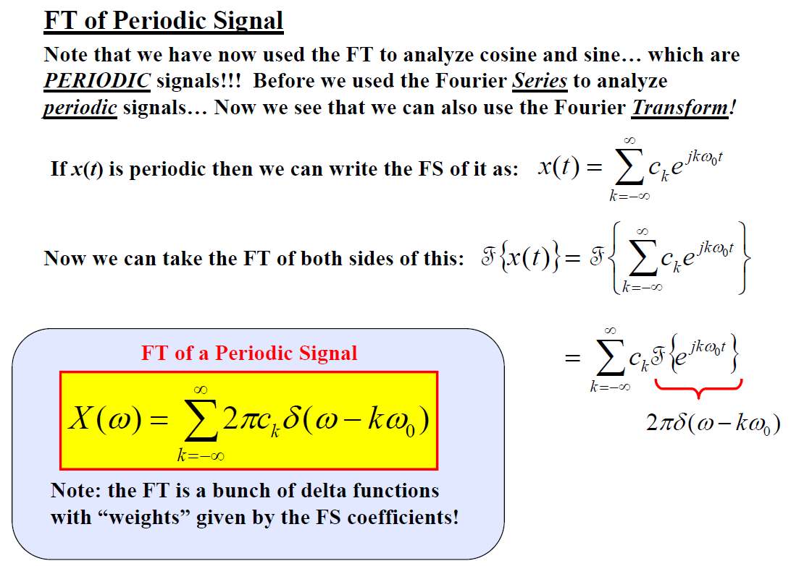
Fourier Transform Table

Slide 29

Fourier Transform Table

Slide 30

Fourier Transform Table

Slide 31

Fourier Transform Table

Slide 32

Fourier Transform Table

Slide 33

Fourier Transform Table

Slide 34

Fourier Transform Table

Slide 35

Fourier Transform Table

Slide 36


Slide 37

Fourier Transform Properties

Slide 38

Fourier Transform Properties

Slide 39

Fourier Transform Properties

Slide 40

Fourier Transform Properties

Slide 41

Fourier Transform Properties

Slide 42

Fourier Transform Properties

Slide 43

Fourier Transform Properties

Slide 44



Scaling Property

Slide 45

Fourier Transform Properties

Slide 46

Fourier Transform Properties

Slide 47


Fourier Transform Properties

Slide 48

Fourier Transform Properties

Slide 49


Fourier Transform Properties

Slide 50



Convolution Property
Convolution in the time-domain
corresponds to MULTIPLICATION in the frequency-domain

Slide 51
Convolution Example
Bandlimited Input Signal
  “sinc” function
Ideal LPF (Lowpass Filter)
  h(t) is a “sinc”
Output is Bandlimited
  Convolve “sincs”

Slide 52


Ideally Bandlimited Signal

Slide 53



Convolution Example 1

Slide 54


Cosine Input to LTI System

Slide 55






Ideal Lowpass Filter

Slide 56





Ideal Lowpass Filter

Slide 57

Fourier Transform Properties

Slide 58

Fourier Transform Properties

Slide 59


Fourier Transform Properties

Slide 60


Fourier Transform Properties

Slide 61


Fourier Transform Properties

Slide 62

Fourier Transform Properties

Slide 63

Application Example

Slide 64

Application Example

Slide 65

Application Example

Slide 66

Application Example

Slide 67

Application Example

